Slide 1
project Miles
Team 8 | Project 1

Slide 2
Introduction
Colin Whitcomb

Slide 3
Team Process
daily huddles including Weekends
Front-end vs back-end
git process
# | Track | Who’s Responsible | Slide Status | Notes
1 | Project Description and basic front-end format library (alternative to bootstrap) | Kait (5 min) | Done | address: a) problem / motivation b) how it addresses the problem, and c) possible source for such data
2 | 3 “MVP” Goals & Stretch Goals | Jen (4 min) | Done | minimum viable product
3 | Three User Stories & Wireframes | Colin (4 min) | Done
4 | Code Modules Each Team member talks about their respective coding piece APIs to be used Marvel Zomato Google Maps Libraries to be used | Gabe (7 min) | Done | Section 1 - Kait - User Account, Bootstrap framework Section 2 - Jen - Prompts, Interact Section 3 - Gabe - (?), charting library Section 4 - Colin - (?)

Slide 4
What It Is
project description
Kaitlin Elisabeth Hulsy

Slide 5
project Miles
Abstract: Fast Food Restaurants have collectively spent 4.5 billion dollars on local advertising this year.
Team 8 | Project 1

Slide 6
project Miles
One third of U.S. children are obese.
Team 8 | Project 1

Slide 7
project Miles
How do we reach them?
Team 8 | Project 1

Slide 8
project Miles
Education, Gaming, and Our Prototype
Team 8 | Project 1

Slide 9
Goals
MVP and Stretch goals for app development
Jen Jayme

Slide 10




In a nutshell...
Health for Teens. Gamified with Avengers.
Educate teens about exercise, nutrition and, eventually, mental health
Promote healthy choices for meals and activities
Make it fun and engaging for youth ages 11-16

Slide 11
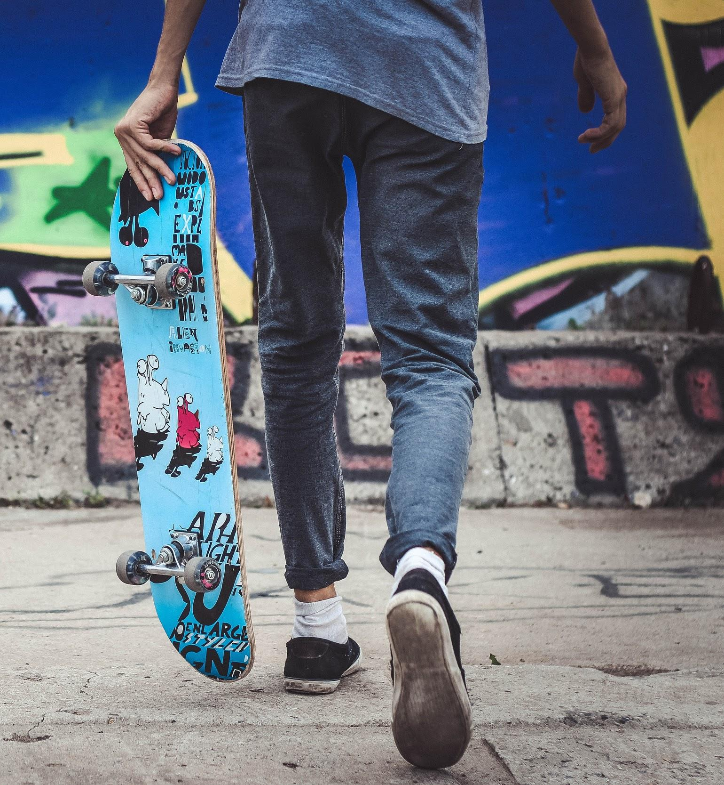
MVP Goals
Landing Page Attractive User-friendly Clear purpose, ways to interact
User Profile User can choose a Marvel character as their avatar. Local storage determines new user vs returning user on visit. DOM greets avatar with personalized text and simple image(s).
User Interactivity * Modals prompt users to choose Grab A Healthy Meal or Get Active * Users prompted to choose mode of travel, Input start/end address * Choices & locations saved to local storage.
Key Functions * App gives tips for local healthy meals, exercise, other health * Award points for healthy choices. * Score displayed and badges added to profile as score grows.

Slide 12
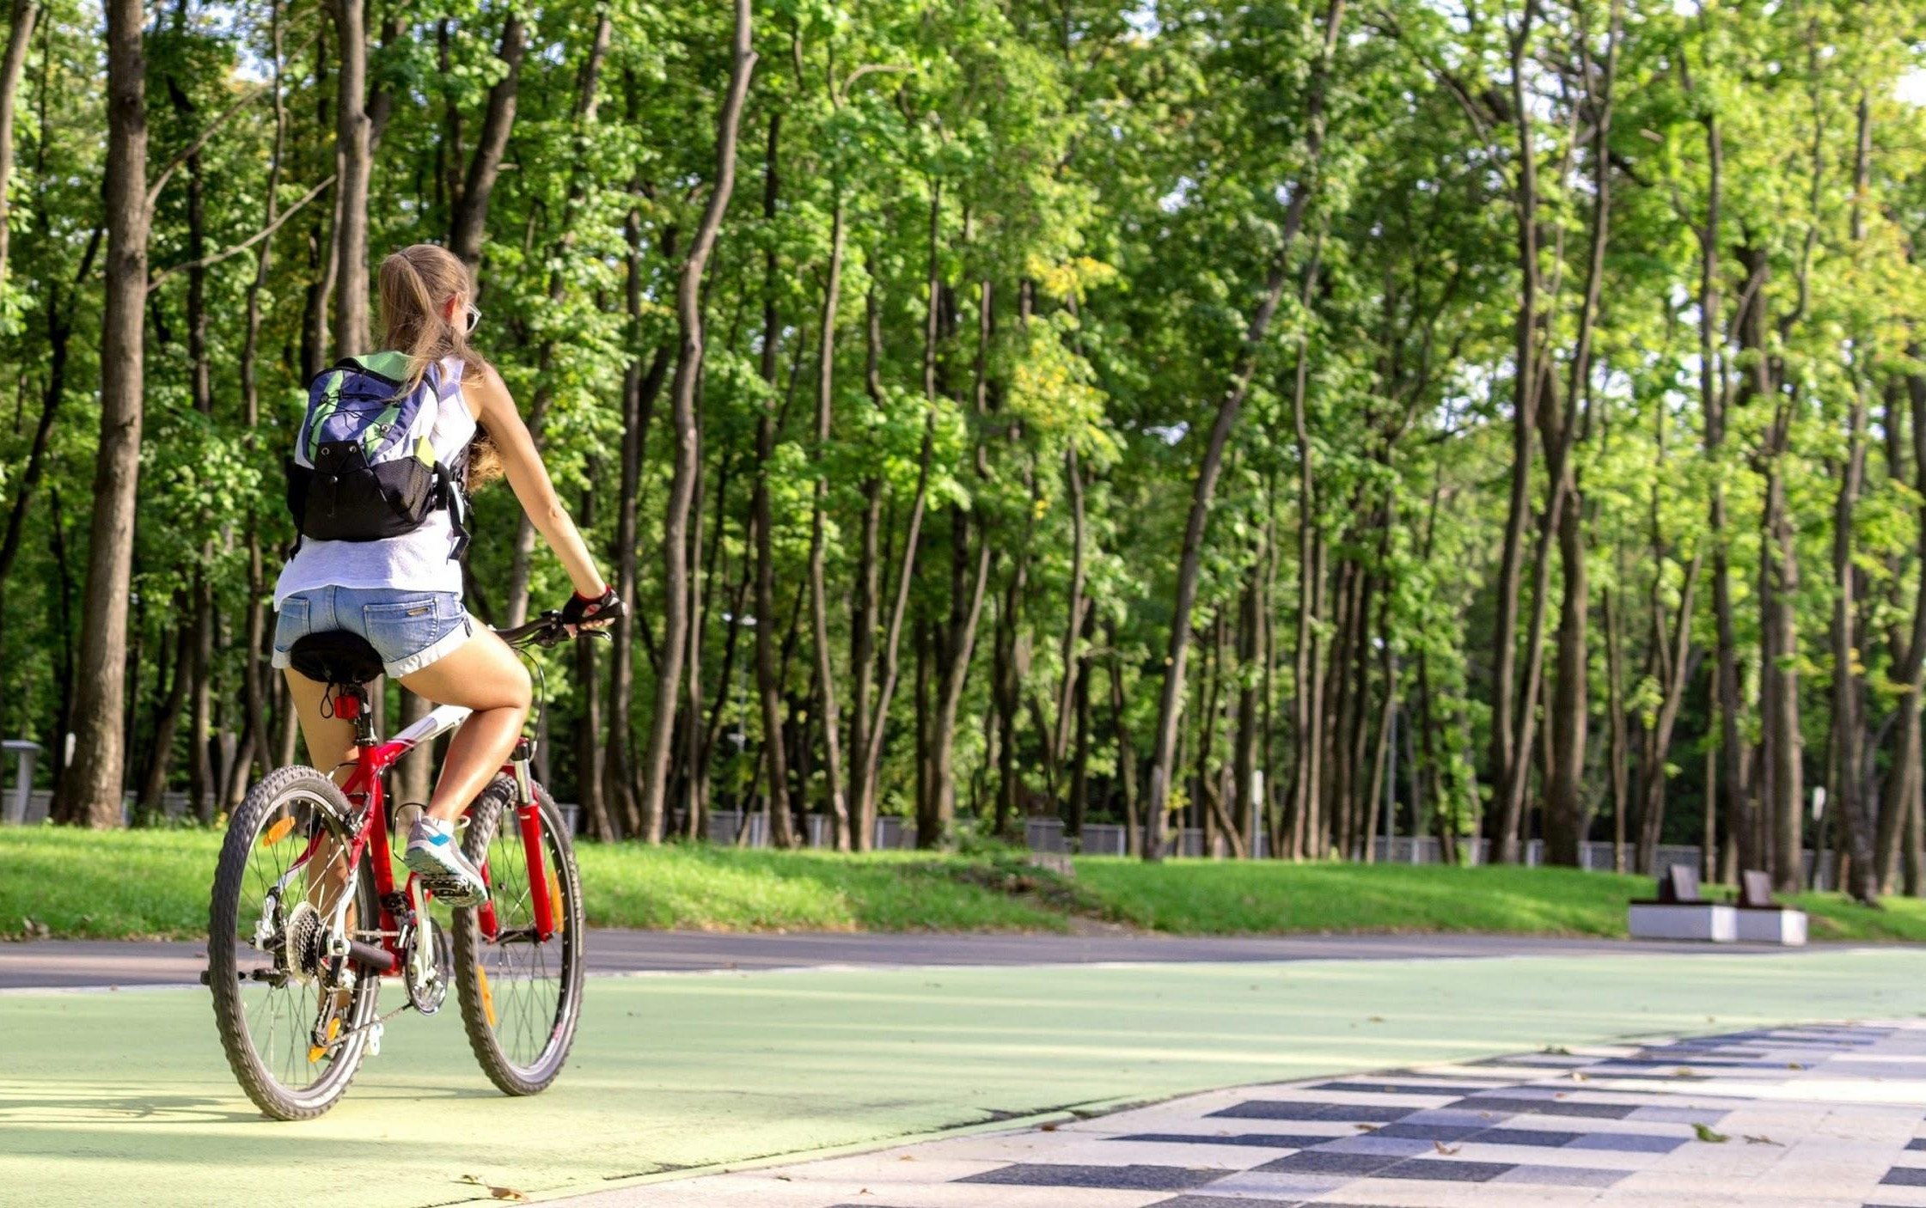
Stretch Goals
Leaderboard Scores of local users reflected on leaderboard.
Unlock New Characters Increased activity enables unlocking of new characters.
Challenges Users are presented with challenges both for characters and selves - e.g., health trivia and/or healthy actions.
Toggle Mode of Transport Users can see how different modes of transport (walk, bike, skateboard) return different points before choosing.
Help Me Find… Function App helps user find a nearby park, hike, bike trail, and start and end addresses returned to function that calculates points for exercise
Mental Health Add mental health tips and resources to exercise and nutrition.

Slide 13
User Stories & Wireframes
meet our target users
and their journey
Colin Whitcomb

Slide 14

Meet Brandon.
I don’t really like to exercise exactly, but I don’t mind if I get exercise while I’m getting somewhere I have to go anyway…
“I want to know how far away something is so I know if I can walk that far or if I should ride my bike instead.”
Earn Points for Biking to School
project Miles calculates the calories burned on the user’s trips to school, the library, the grocery store and to hang out with friends, and awards points for exercise on these routes.

Slide 15

Meet Nicole.
My friends and I go out to eat after school a lot. We want to eat healthy but we usually go to the first, closest place we can think of and order french fries. We might try new places if we had a fun way to find healthy meals nearby...
“I want to see restaurant options in my area so that I can choose the location with healthier choices.”

Slide 16

Meet Sam
I hang out at my friends’ house after school all the time. I usually get a ride from my mom, but I guess I could ride my bike or skateboard...
“I really love games. Project Miles makes exercising fun!”
project Miles

Slide 17
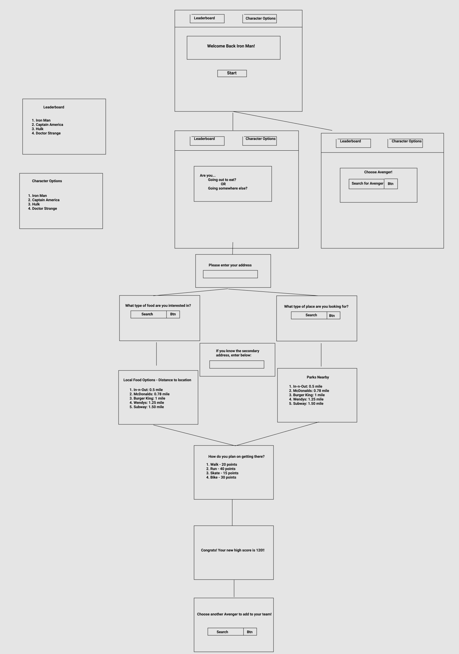
Wireframe
User Experience

Slide 18

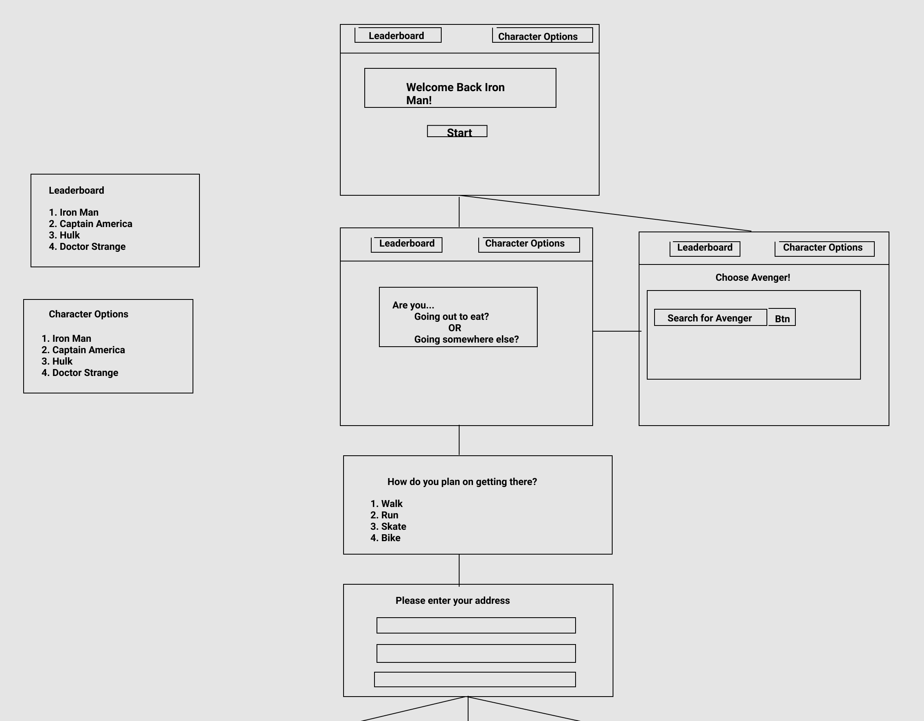
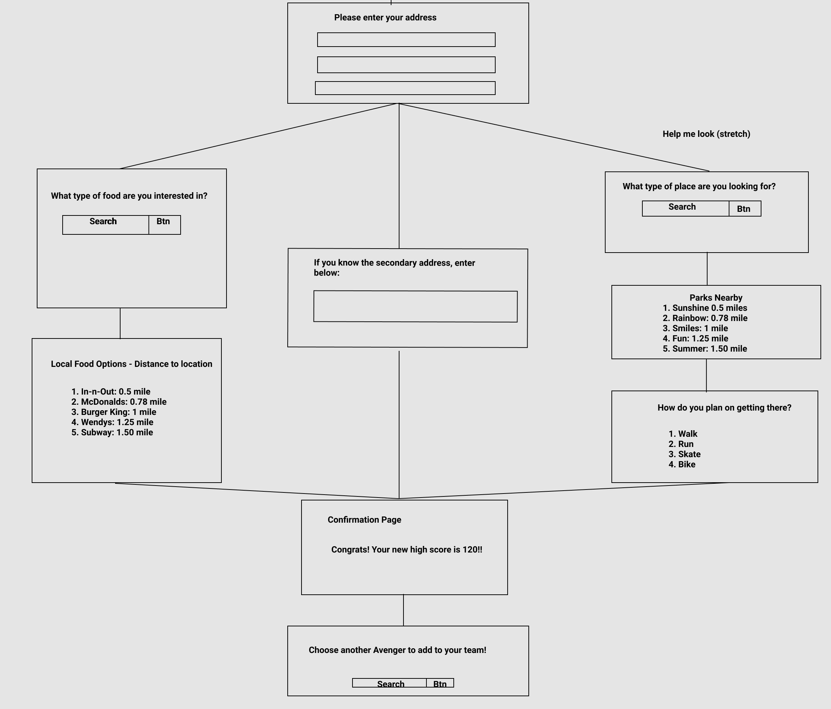
Wireframe cont...

Slide 19
Code Sections
| User Account | Interactivity |
| APIs & Libraries | Key Functions |
Gabe Sucich

Slide 20
Code Modules
Geocoder and OpenRoute APIs
Converts addresses to geocoordinates.
Route distance calculated from geocoordinates`of starting point and destination are
User Profile:
Stores user profile information in local storage
Stores user score in local storage
Sends any addresses input by use
Sends new points to update score
Geocoder and Zomato Restaurant
Converts current address to geocoordinates.
Finds nearby restaurants matching search query.
User Interaction:
Prompts the user about the nature of activity
Stores locations in local storage for future reference
Stores algorithm for calculating points earned
Sends user address and food preferences

Slide 21
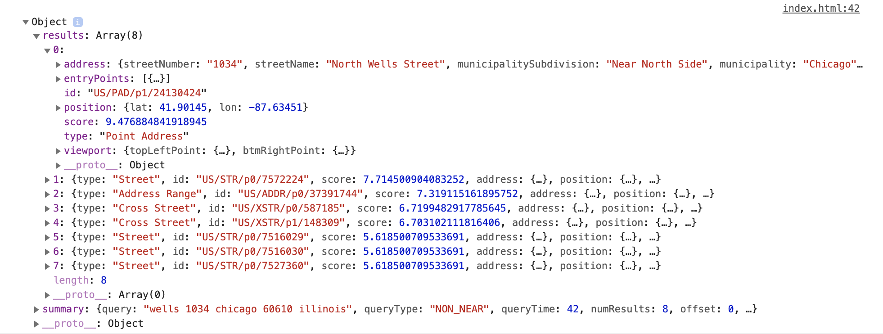
TomTom Geocoder API
https://api.tomtom.com/search/2/structuredGeocode.JSON?key=[api_key]&[address_info]

Slide 22
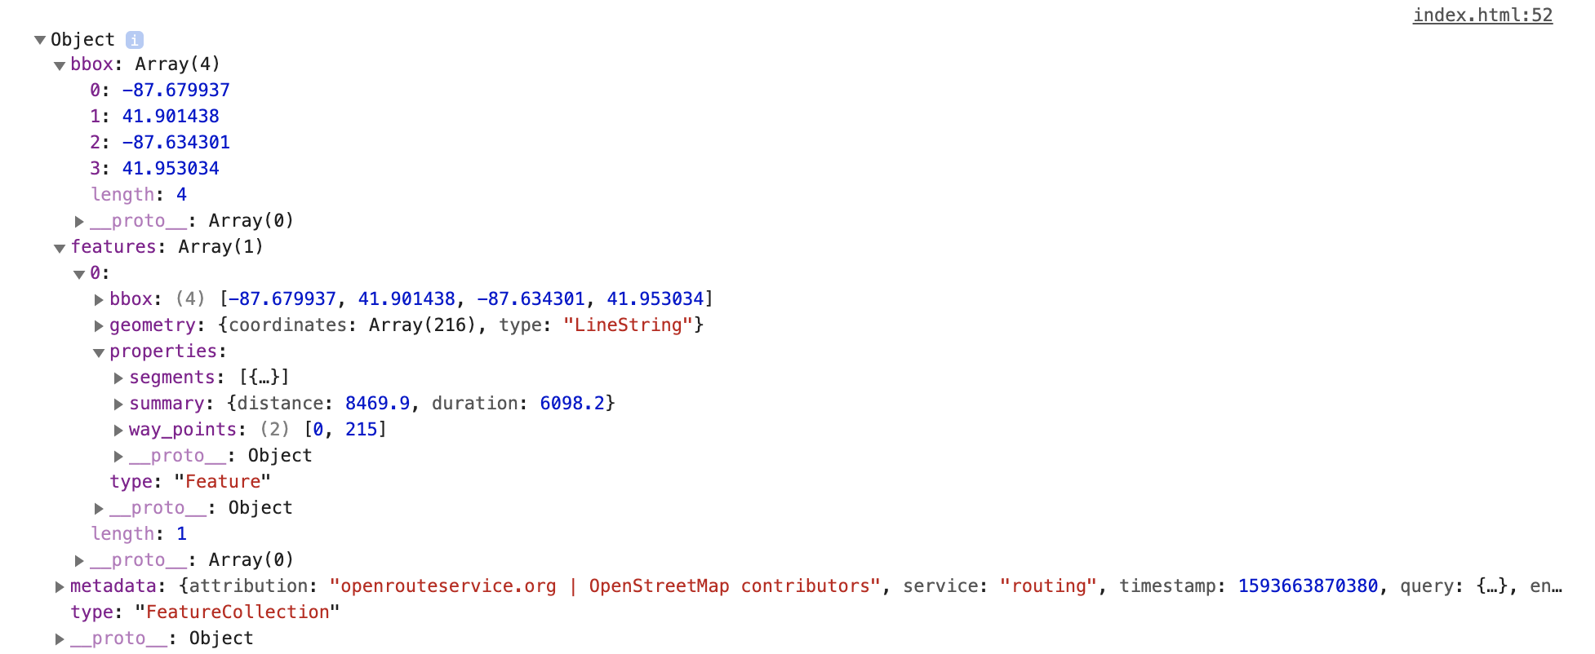
OpenRoute API
https://api.openrouteservice.org/v2/directions/foot-walking?api_key=[api_key]3&start=[coordinates]&end=[coordinates]

Slide 23
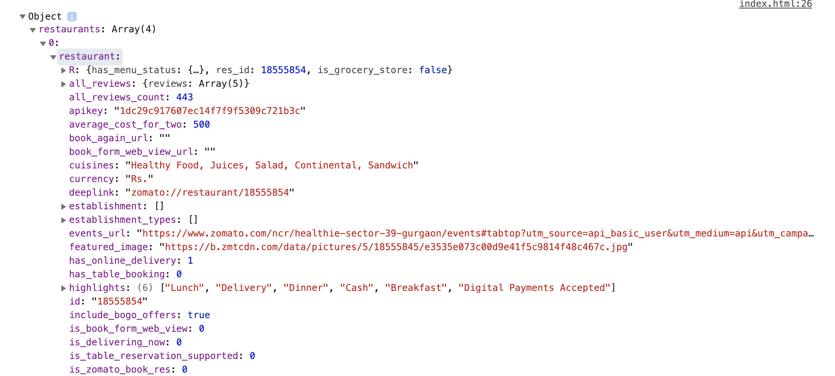
Zomato API
https://developers.zomato.com/api/v2.1/search?q=[food_query]&lat=[lat]&lon=[lon]&radius=[miles]

Slide 24
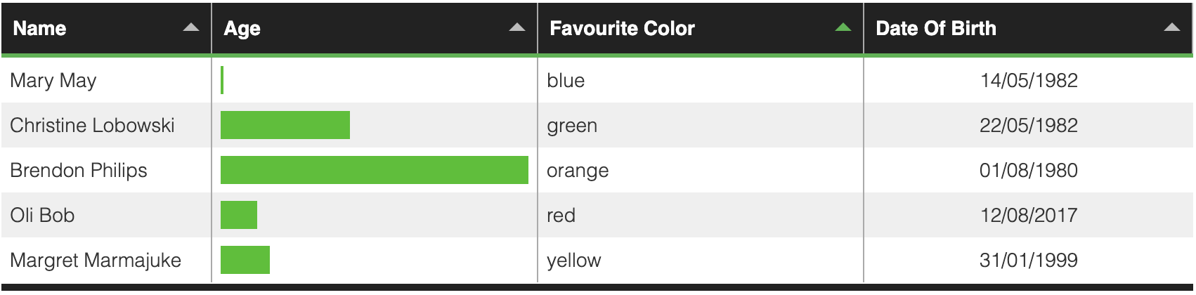
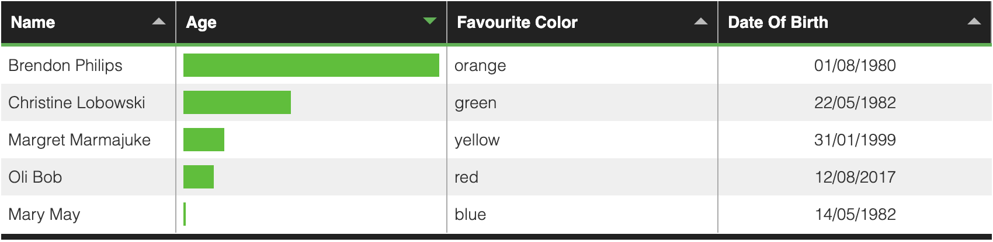
Tabulator

Slide 25
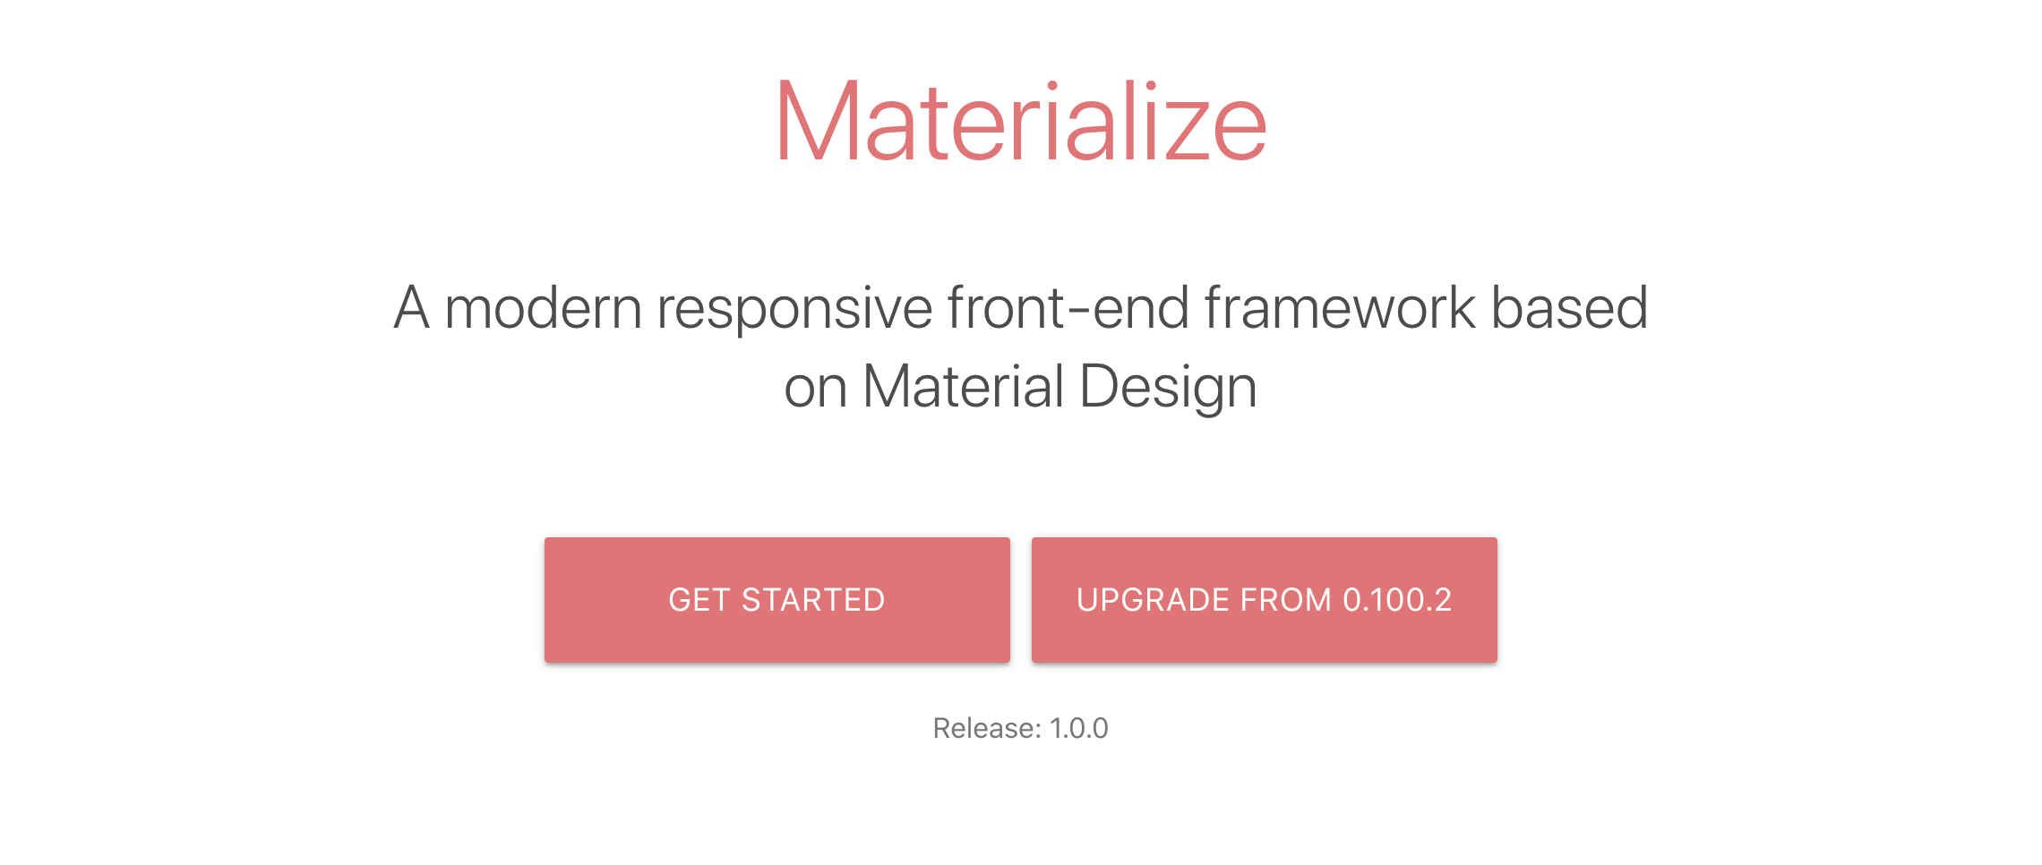
CSS Framework

Slide 26
Questions?

Slide 27
project Miles
Thanks
for your
attention!
Team 8 | Project 1

